Slide 1
Department of Mechanical and Manufacturing Engineering Project Presentation

Slide 2
Overview
Group one: Verify the theoretical equations
Group two: optimize cutting condition for maximize material removal rate
Group three: design a new experiment

Slide 3
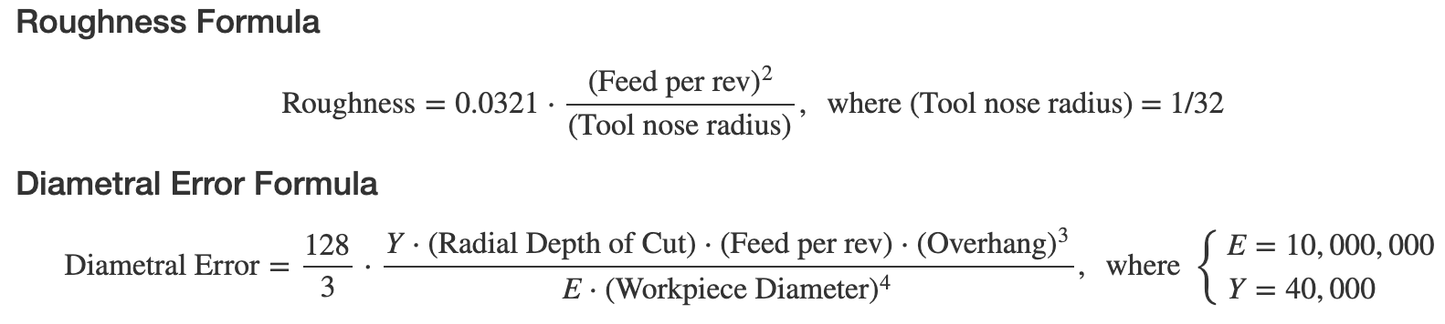
Goals & Background
Group one: Verify the theoretical equations
When given theoretical equations we often see the information gleaned from them as the truth. These equation will hold true when certain assumptions and ideal conditions are met, but how do they perform when outside of a controlled. Will these theoretical equations be shown to be self evident if when we reverse engineer them? That is what we set out to solve in this project.

Slide 4
Goals & Background
Group two: optimize cutting condition for maximize material removal rate
While the purpose of this lab was to demonstrate the effects of different conditions on the quality of the finished product and to understand interactions between factors, the main question this analysis will address is how to optimize cutting conditions in order to maximize material removal rate while staying within acceptable bounds for roughness and dimensional accuracy. The MME lab produced 54 observations with 21 variables, but the ones of key interest to this project are roughness, tip and chuck end diameters, feed rate, rotation speed, and depth of cut.

Slide 5
Goals & Background
Group three: design a new experiment
We specifically look at I-optimal Split-Plot Response Surface designs, which include at least one hard-to-change factor. That factor here is Depth of cut (DOC), as the client’s preference is to be provided with conditions of other variables while at the same level of DOC. We provide our clients a table with 13-run settings for 13 groups to execute the experiment, and recommend 4 more optional ones in case they have 17 groups instead. The statistical software that was mainly used to construct this design was the JMP Design of Experiment (or DOE) platform.

Slide 6
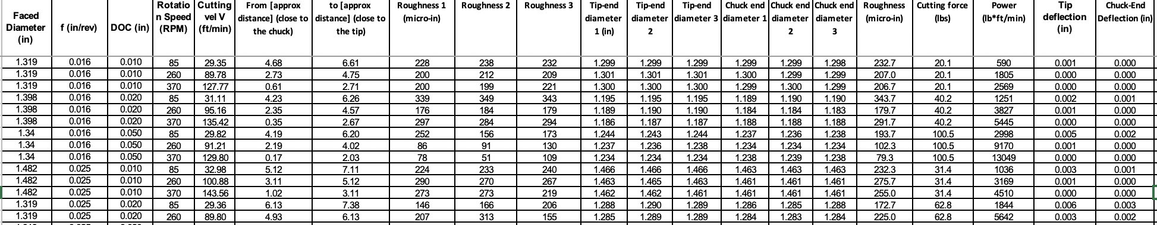
Data

Slide 7
Data Cleaning and Handling
Removed 6 missing values (no “Faced Diameter”)
Calculated Diametral Error by the given Equation:
Diametral Error = Turned Diameter - Ideal Turn Diameter
Turned_ideal ：Faced Diameter (in)−2⋅DOC (in)
Diametral Error Outliers:
One workpiece (Faced Diameter:1.464), around 1
Another workpiece (1.398), around 0.16-0.17
Others, less than 0.025
We removed the first two groups, now we have 42 observations.
、

Slide 8
Group One: Verification of Two Theoretical Equations
Overview
Big picture
Exploratory Data Analysis
Linear Regression Model
Linear Mixed Effect Model
Results
Concerns & Suggestions

Slide 9
Theoretical Equation

Slide 10
Big Picture
Estimate the parameters of our model based on data
Compare to the parameters of theoretical equations
Specified Data:

Slide 11
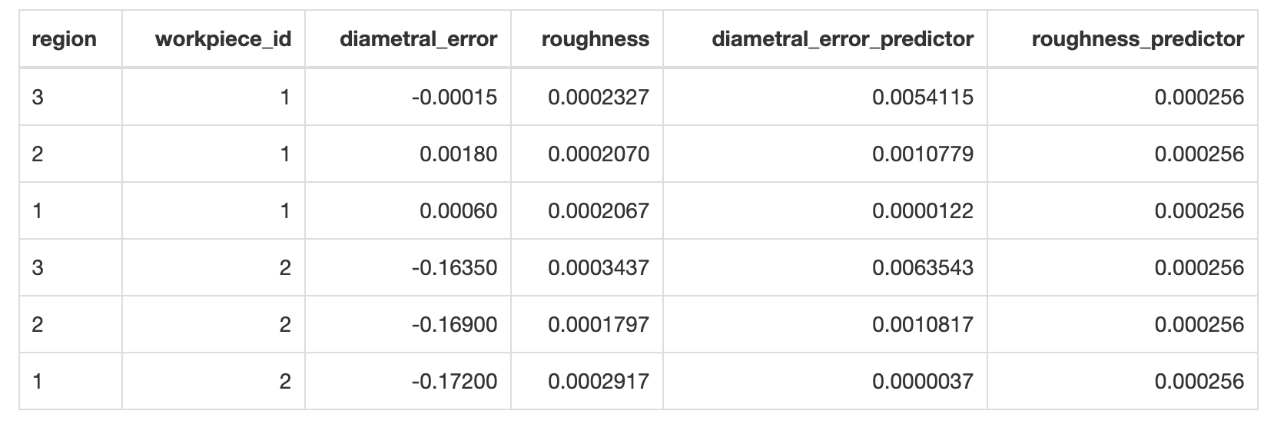
Specified Data
Sample Data
Predictors: Calculated by the theoretical equations based on the empirical data

Slide 12
Specified Data
Variables:
diametral_error_predictor: all non-constants in diametral error formula.
roughness_predictor: all non-constants in roughness formula.
region: Region of workpiece. Region 1 = Chuck-end, Region 2 = Mid-workpiece, and Region 3 = Tip-end.
workpiece_id: Workpiece or “group” the observation belongs to.
diametral_error: calculated value of diametral error from data.
roughness: calculate value of roughness from data.

Slide 13
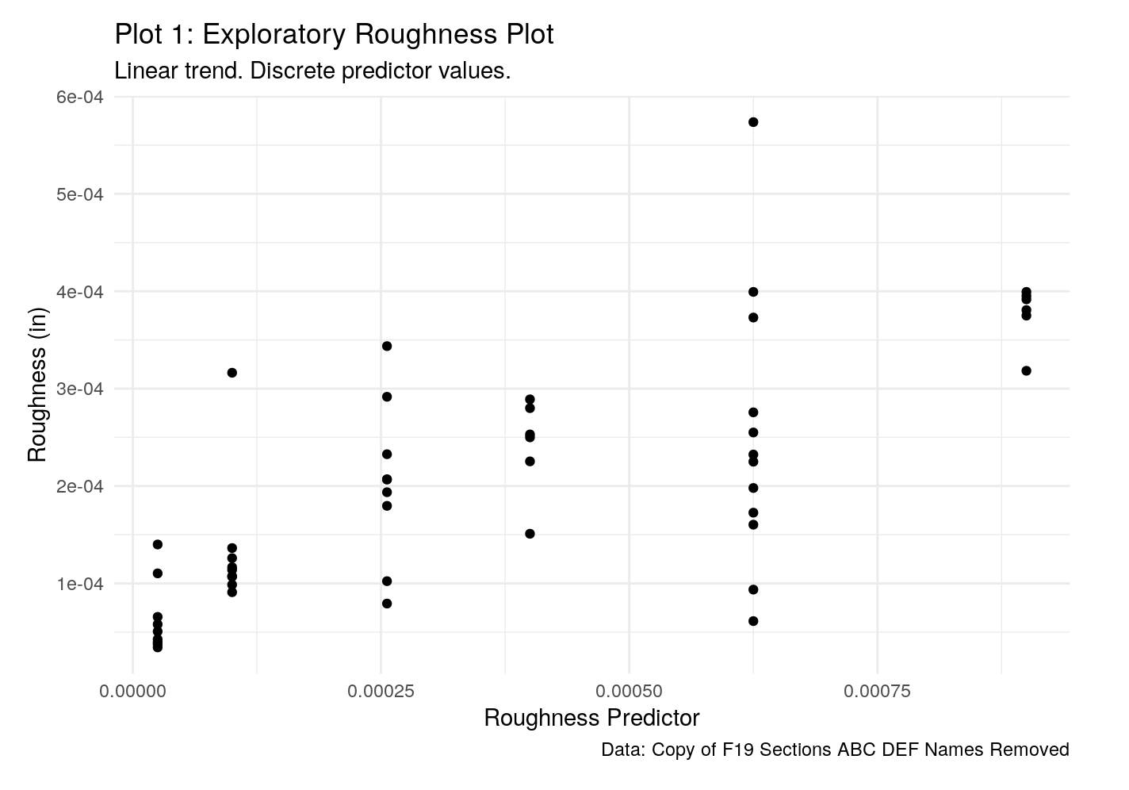
Exploratory Data Analysis

Slide 14
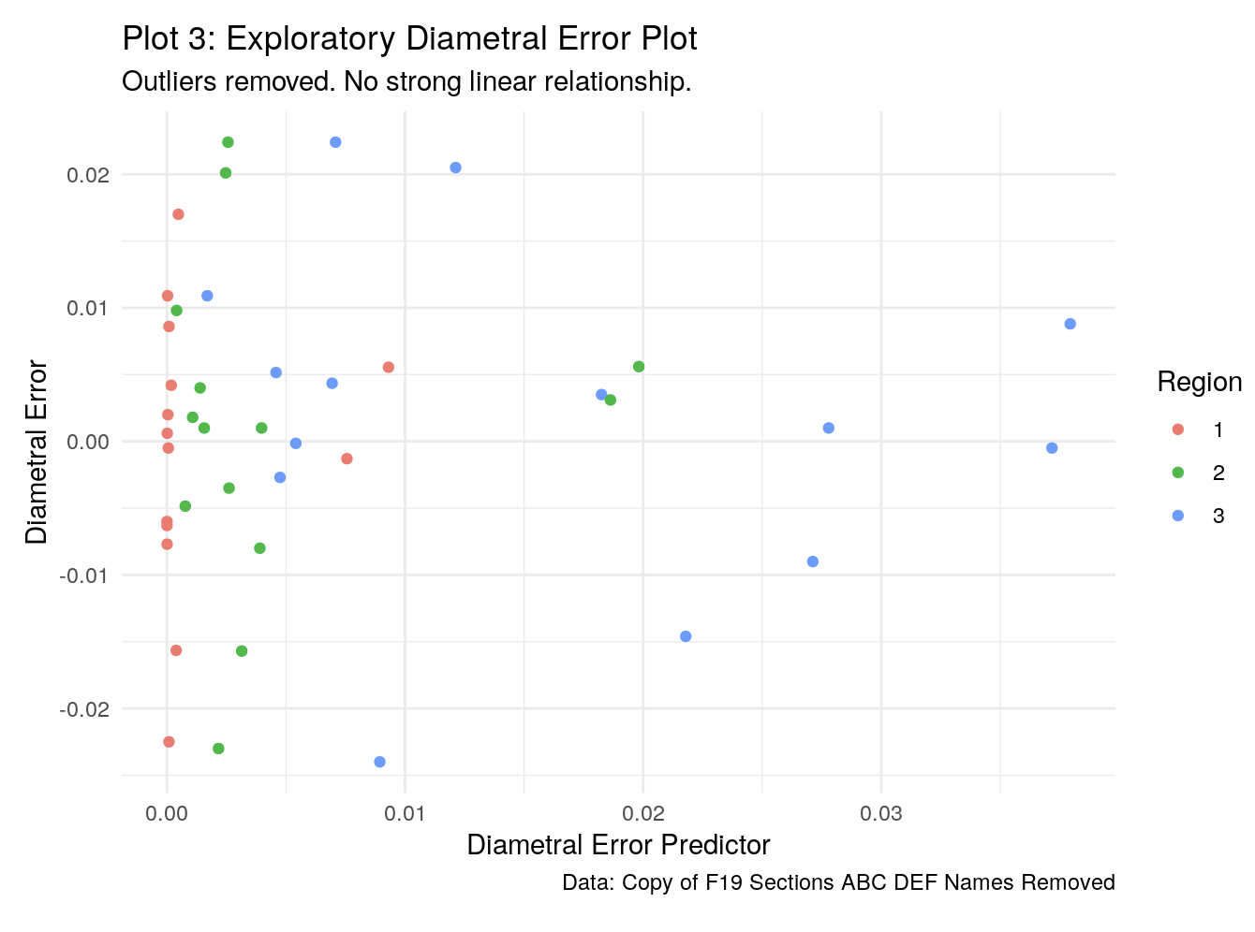

Slide 15
Linear Mixed Effect Model
No intercept
i = 1,2,3…,16 (16 workpieces)
j = 1,2,3 ( 3 regions)

Slide 16
Linear Mixed Effect Model
Why ?
We chose a linear mixed-effects model due to the correlation within groups we would expect amongst roughness measurements on the same workpiece.

Slide 17
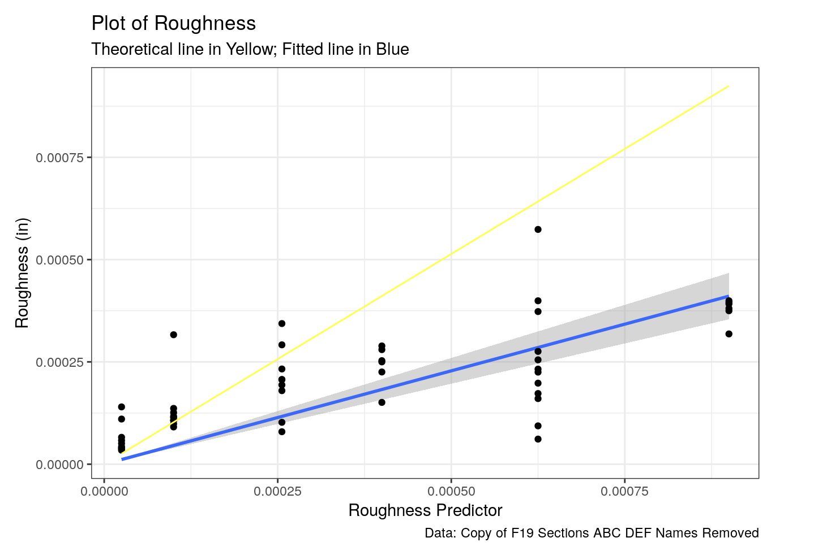

Slide 18
Results (Roughness)
Number of reasonable Values of slope parameter
Ideal parameter: 1.0272
The parameter calculated by the roughness formula
Does not fail in the above range

Slide 19
Linear Regression Model
No intercept
This equation is computed for every region on the workpieces so there are essentially three equations derived using this methodology.

Slide 20
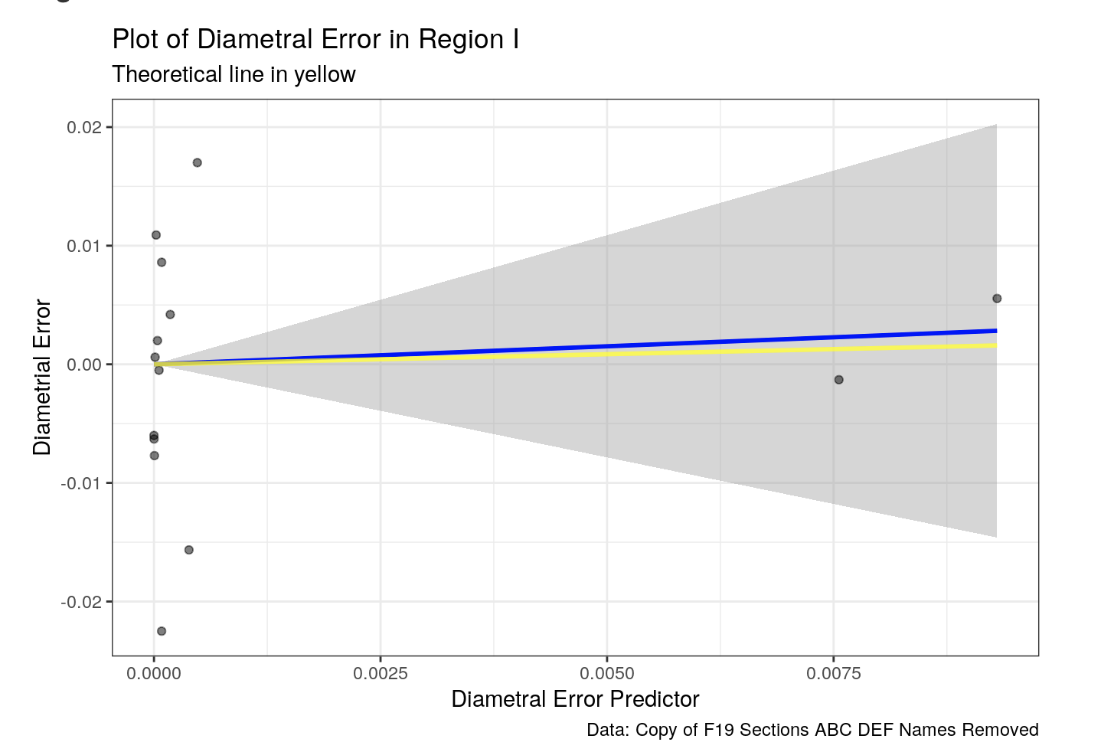

Slide 21
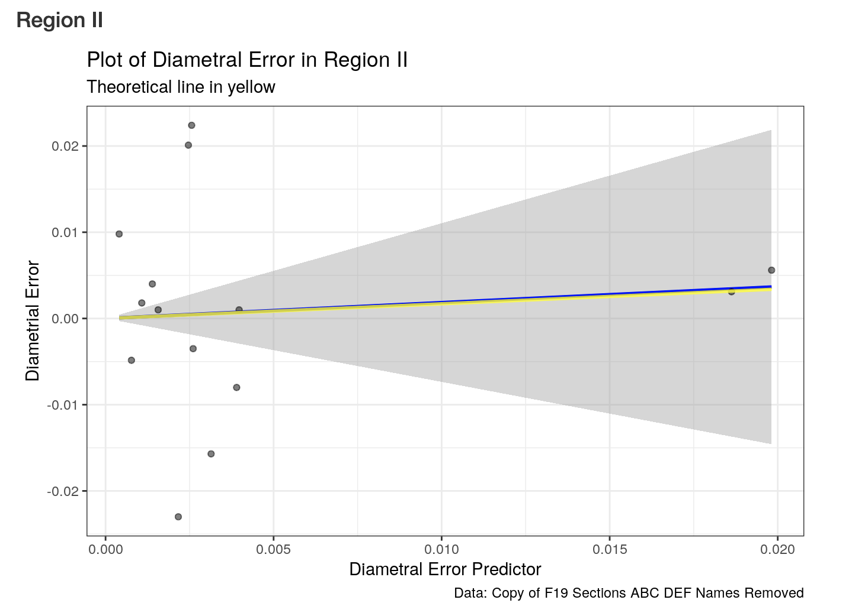

Slide 22
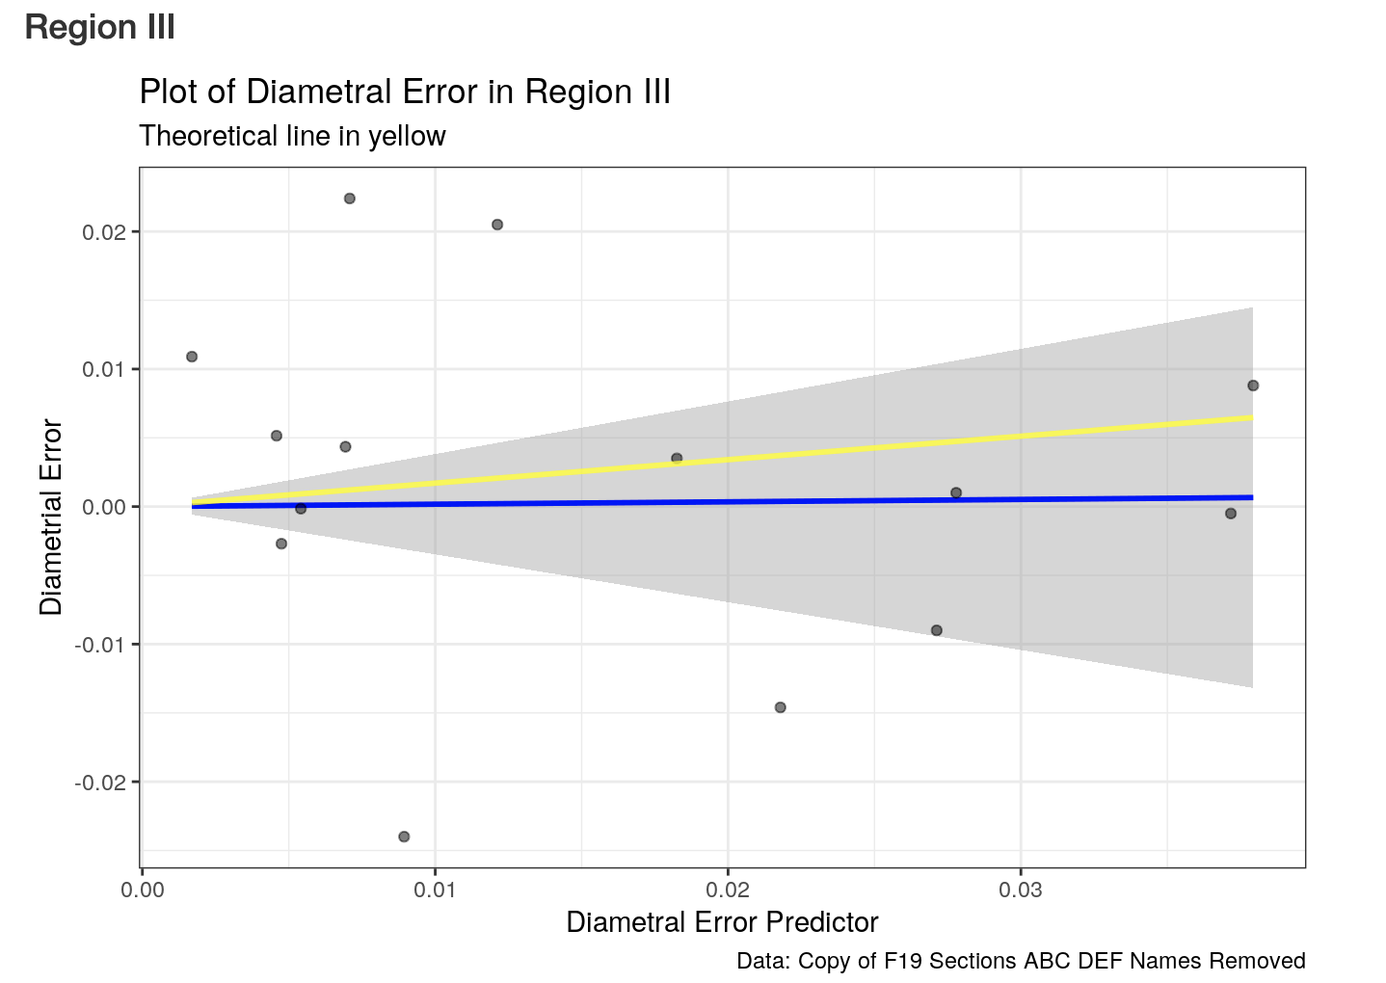

Slide 23
Result (Diametral Error)
Seem like pretty good comparisons
Look at
R squared : 0.007846729
Adjusted R squared : -0.06847275

Slide 24
Results (Diametral Error)
What does low R squared and adjusted R squared which are approaching zero tell us?
The linear regression model based on the data predicts diametral error poorly
We have really large uncertainty.
All conclusions based on this model are unreasonable.

Slide 25
Concerns
Data Size
Lack of independence (verification purpose)
Usually statistics isn’t set up to test the equivalence. We basically reject the null hypothesis, the parameter is a certain value

Slide 26
Suggestions
Increase Data Size. Run experiments as many as you can.
Randomization. Consider re-design the experiments for verifying theoretical equations.
Explore other methods

Slide 27
Determining Optimal Cutting Conditions
Overview
Regression Model
Split-Plot Model
Optimization
Results, Recommendation, & Caveats/Concerns

Slide 28
Regression Model
Predictors
Feed Rate, Depth of Cut, and Rotation Speed
Will include two factor interaction terms between the three
Response surface to account for curvature
Overhang
Treated as Covariate
May account for variation, but can’t be truly controlled
Notes:
Should this be its own slide, or should this be what I talk about while the model itself is shown on the screen?

Slide 29
Regression Model
Responses
Roughness
Tip Diameter Error
Chuck Diameter Error
Material Removal Rate
Only Modeled to be used in optimization scheme

Slide 30

Regression Model Form

Slide 31
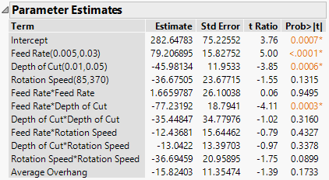
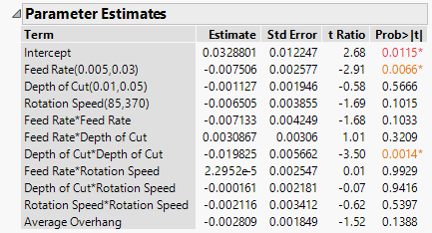
Regression Model Parameter Estimates
Roughness Model Tip Error

Slide 32
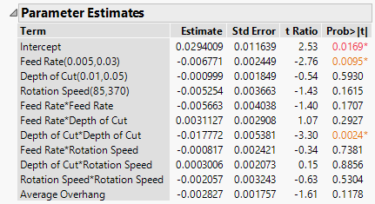
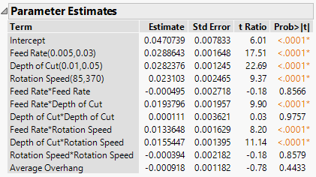
Regression Model Parameter Estimates
Chuck Error Material Removal Rate

Slide 33
Split-Plot Model
Background/Why a Split-Plot Model
Regression Model Doesn’t Fit Design of the Lab
Feed Rate & Depth of Cut are “Hard to Change” factors
Held constant within each group
Rotation Speed is not
Varied within each group
Two different levels of randomization require two different error terms
Whole Plot Error Term
Split-Plot Error Term

Slide 34

Split-Plot Model
Model Form
Whole Plot Factors: Feed Rate, Depth of Cut
Whole Plot Error Term: Random Group Term
Split-Plot Factor: Rotation Speed
Split-Plot Error Term: Residual

Slide 35
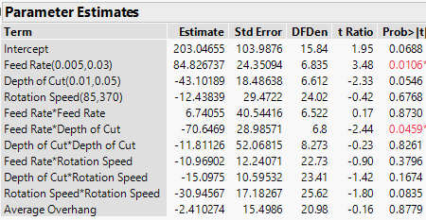
Split-Plot Model
Parameter Estimates & Significance Tests Change
Split-Plot Roughness Regression Roughness

Slide 36
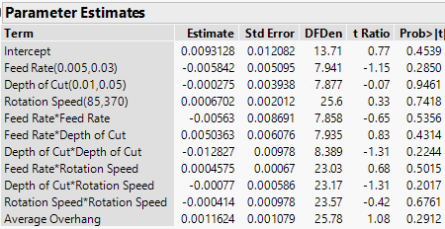
Split-Plot Model
Parameter Estimates & Significance Tests
Split-Plot Tip Error Regression Tip Error

Slide 37
Split-Plot Model
Results
Whole-Plot Factors Harder to Detect
Whole-Plot error term (Group Random)
Likely Accounts for much of the variation in results
Variance component estimate is very large for the tip and chuck error (estimated over 90% of variation)
Smaller for roughness, but also potentially exists (estimated 50% of variation)

Slide 38
Other Results & Model Selection
Ran the Split-Model removing average overhang
Changed the Results
Likely due to high correlation between rotation speed and overhang
Discussed further in the caveats section
Optimization Ran on Split-Plot Model
More Accurate model based on design of the lab
Used Full model with overhang

Slide 39
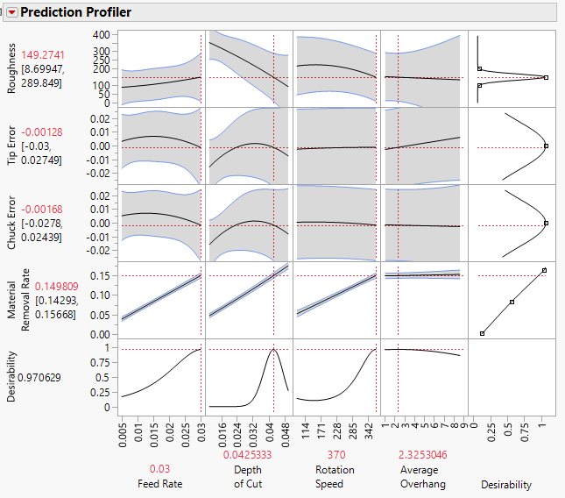
1.5” Diameter

Slide 40
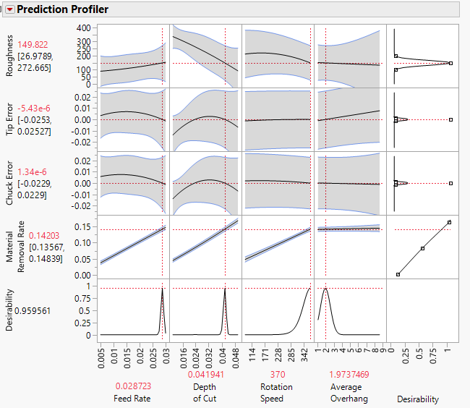
1” Diameter

Slide 41
Results/Recommendation
Optimal Cutting Conditions
1.5 Inch Diameter Section of Workpiece
Feed Rate: 0.03 in/rev
Depth of Cut: 0.0425333 in
Starting Face Diameter: 1.5850666 in
Rotation Speed: 370 RPM
1 Inch Diameter Section of Workpiece
Feed Rate: 0.028723 in/rev
Depth of Cut: 0.041941 in
Starting Face Diameter: 1.083882 in
Rotation Speed: 370 RPM

Slide 42
Results Using Regression Model
1.5 Inch Diameter
Feed Rate 0.03 In/Rev
Depth of Cut 0.0438257 In
Starting Face Diameter 1.5876514 In
Rotation Speed 370 RPM
1 Inch Diameter
Feed Rate 0.0274 In/Rev
Depth of Cut 0.0416893 In
Starting Face Diameter 1.0833786 In
Rotation Speed 341.63705

Slide 43
Results/Recommendation
Expected Material Removal Rate
1.5 Inch Diameter Section of Workpiece
0.19529 in^3/min
1 Inch Diameter Section of Workpiece
.1265 in^3/min

Slide 44
Caveats, Concerns, & Moving Forward
Caveats & Concerns
22.22% (12/54) experimental runs removed due to outliers or missing data
Rotation Speed was not randomized in the split plot
Possible extrapolation
recommended face diameters not tested in any run of the lab
Moving Forward
Validation runs with recommended cutting conditions
Well Designed experiment in the neighborhood of interest

Slide 45
Part III: Experimental Design
Introduction
Method
Result

Slide 46
Question
“Based on the original experimental dataset, how should we revise the experimental method and create a new design?”.

Slide 47
Introduction
Goal: Design a revised experiment
Prediction Factors Considered:
Feed Rate
Depth of Cut
Rotation Speed
Response Factors Considered:
Diameter Error
Roughness

Slide 48
Method: General Idea
We will use I-optimal split-plot response surface design methods
The first level is used to assign a group (or “whole plot”) to a specific level of DOC - the hard-to-change factor.
The second level of randomization is used to assign the subplot experimental units to levels of the easy-to-change factors.

Slide 49
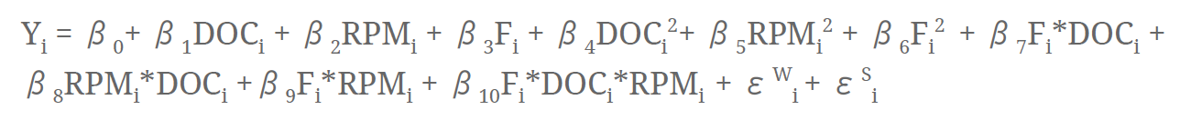
Method: Response Surface
Response surface methodology tells us that general model we use here will include main effects, quadratic terms and interactions.
It gives us a response surface model.
Useful for finding the level of variables that optimize the response and selecting the operating conditions to meet specifications.

Slide 50
Method: I-Optimal Design
As we construct our experimental design
Measure statistical quality and make sure that it is optimal to some statistical criteria.
Opt for an optimality-criterion that is concerned with the variance of predictions, which is I-optimality.
I-optimal minimize the average variance of prediction over the region of experimentation, so it focusing on prediction

Slide 51
Method: Table for Factors and Levels
Table: Factors and Levels
Factor | Type | Low level | Center level | High level
Feed Rate | Easy to change | 0.015 in/rev | 0.03 in/rev | 0.045 in/rev
Rotation Speed | Easy to change | 85 rpm | 370 rpm | 655 rpm
Depth of Cut | Hard to change (fixed every group) | 0.035 in | 0.04 in | 0.045 in

Slide 52
Result
After we design the experiment by split-plot response surface method:
We have 17 whole plots, each one has 3 trials, 51 runs in total.
In the 17 whole plots, we have 4 optional whole plots.
Additional information in experiment:
The experiment must be conducted in randomized order we suggest, even though same variable setting is possibly.
For each run, you have to reset the setting of machine accordingly

Slide 53
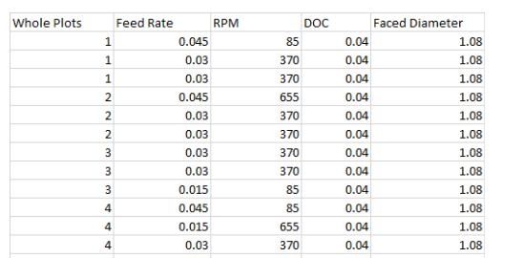
Result: Table for Experimental Settings
Faced Diameter = (1 + 2*DOC)

Slide 54
Thank You

